Slide 1
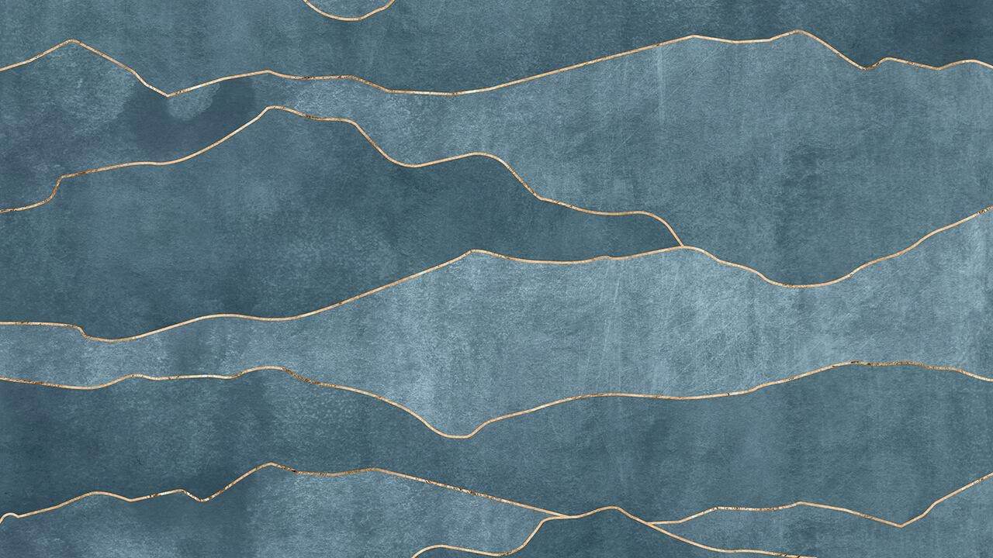

Green AI Challenge
proposed solution by Team
“Clear Vision”
Our Works : https://github.com/Mahos-H/ClearVision
1

Slide 2
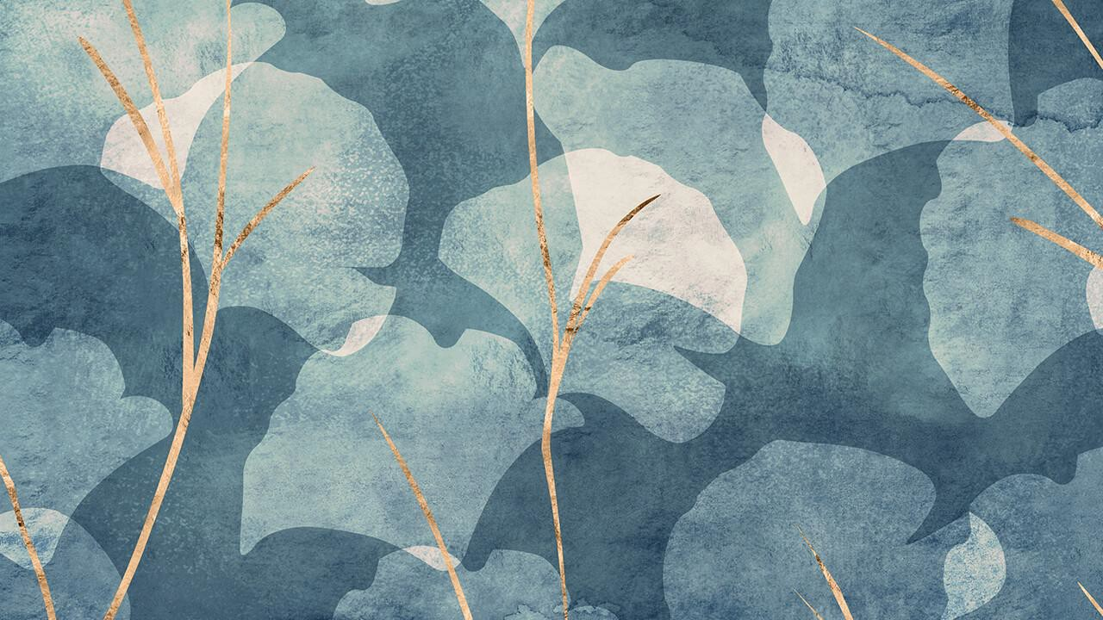

Pro

Slide 3

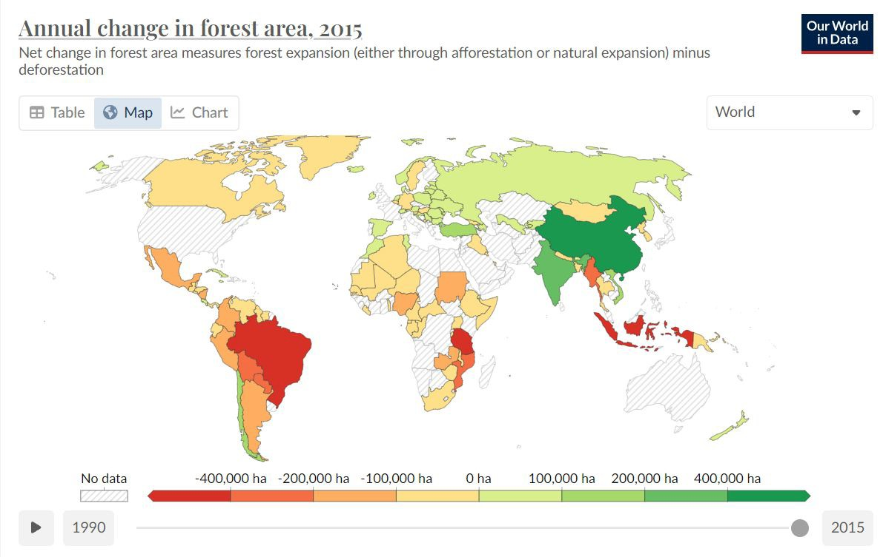

MAPS
our ofﬁce
Find more maps at slidescarnival.com/extra-free-resources-icons-and-maps
https://ourworldindata.org/grapher/annual-change-forest-area?time=2015
3

Slide 4
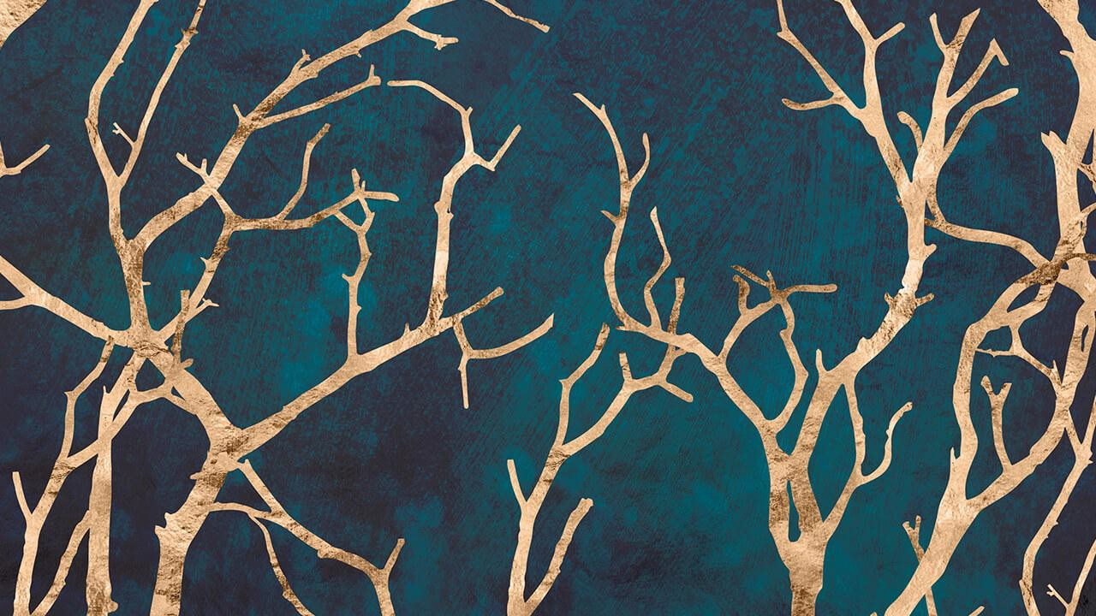

Problem Statement: Using ML/AI to compare drone images of an afforestation patch
and point out casualties.
Odisha forest department plants nearly 5 crore trees every year across the state. Afforestation programs are taken up over patches of irregular shapes and sizes and models that depend on the existing vegetation density of the
patch.

Slide 5
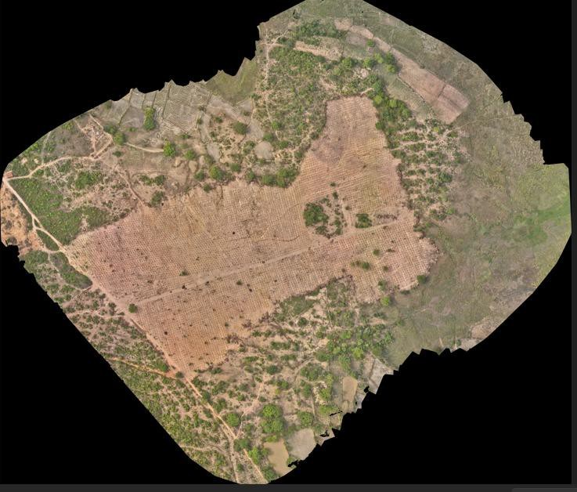
Post OP 1
OP1: During March-to-May period of Year 1, pits of size 45x45x45cm are dug up and left to the sun to kill any microbes. This is carried out by manual labor or digging machines (JCBs) with fixed size buckets and is easily visible from the sky.

Slide 6
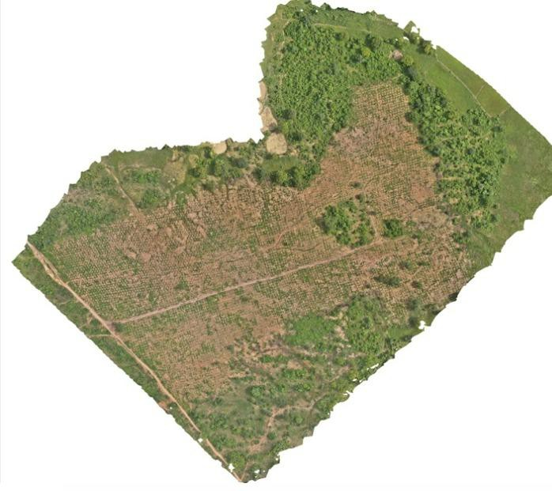
Post OP2
OP2: During the first monsoon rains and subsequent month (June 15 to July 30), planting of saplings is carried out. The saplings are 18 months old and are 4 to 6 ft tall depending on the species with minimal foliage.

Slide 7
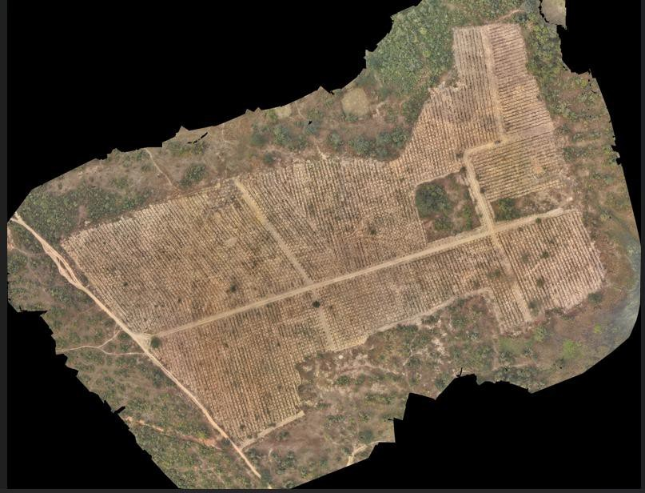
Post OP3
OP3: During Oct-Nov of Year 1, for weeding, a diameter of 1m soil is cleared around the sapling, which is visible from the sky. The same operation is conducted during Year 2 and Year 3 during the same period

Slide 8
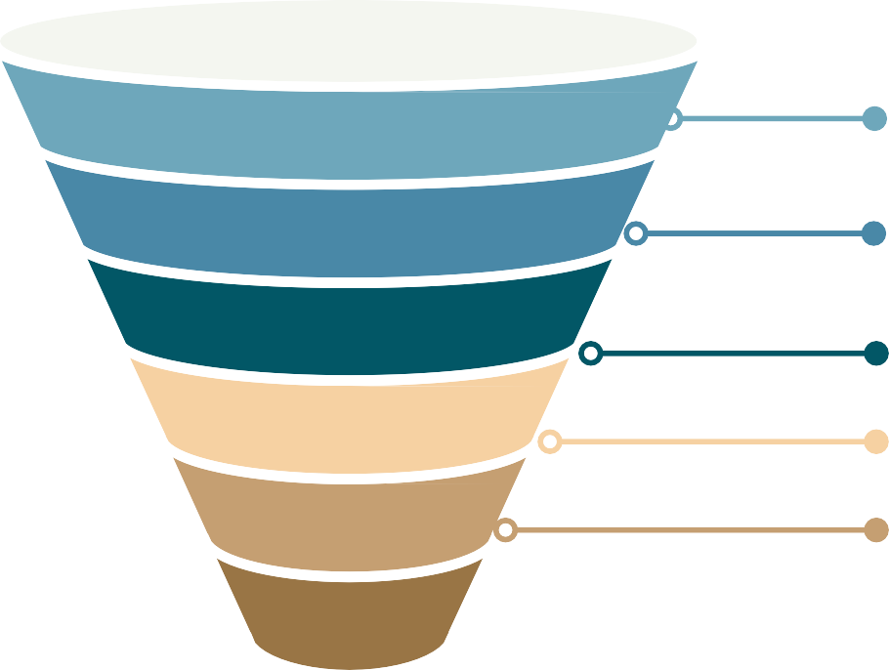
Pipeline for the Project
Open Drone Mapping, Pix4D, Python Libraries
OpenCV, K Means Clustering, Rasterio, Scikit-Images
Data Exploration
Data Pre-Processing
Feature Engineering
Geodata Extraction, Pit Detection
and Indexing
NDVI Sapling Detection, Health Estimation
Mixed Precision evaluation + Health Embeddings
Survival Rate Calculation, Possible Factors of Death
Model Training
Evaluation
Predictions

Slide 9
Step 1 : Understanding the Dataset
The main challenge we faced.

Slide 10
FlowChart of Data-Exploration
Extracting Metadata from .TIFF ﬁles
Match the Drone Images
Noise Reduction from
.TIFF Images
Model Training and Evaluation
Further Data Exploration
Isolating the Area of Interest
Exploring more methods
10

Slide 11
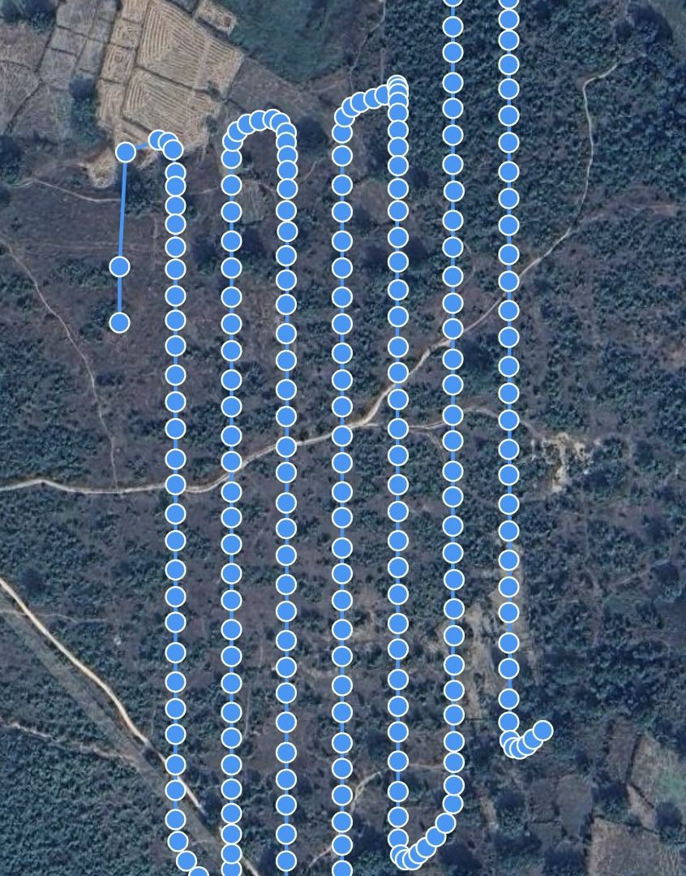
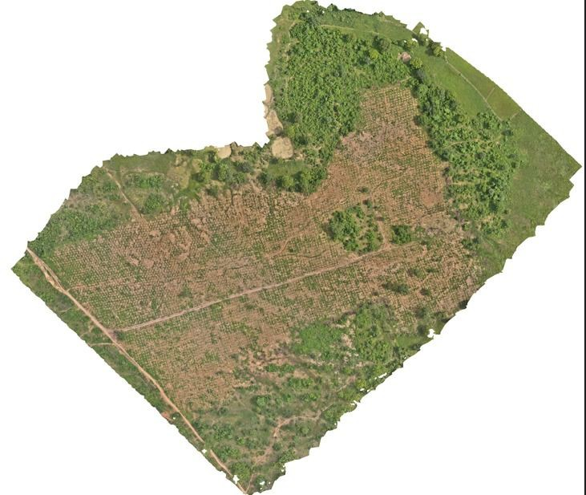
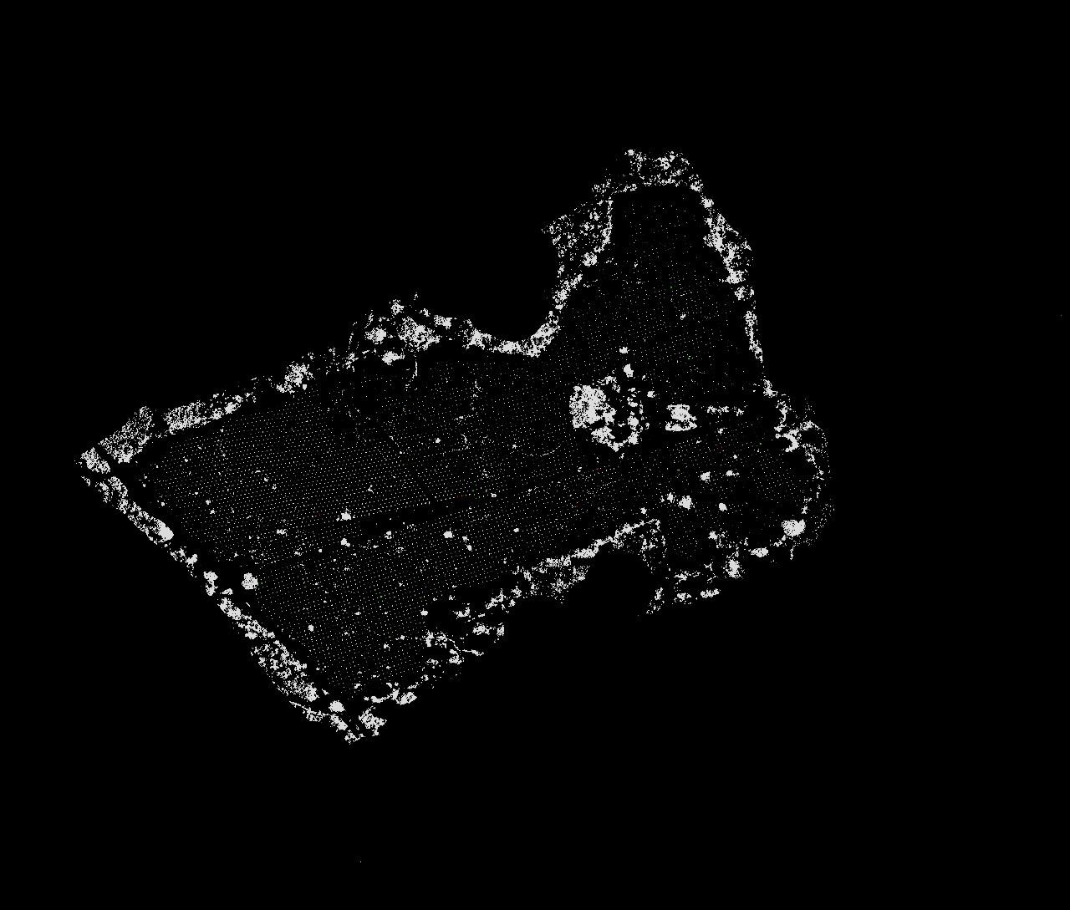
Mapping the small images with the Drone Path and reconstructing the pits in the plot

Slide 12
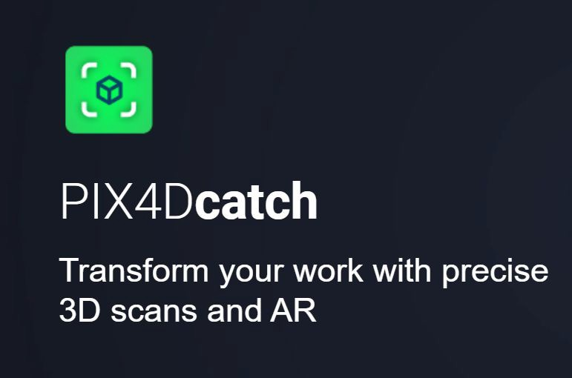

Software toolkits used for Data Exploration

Slide 13
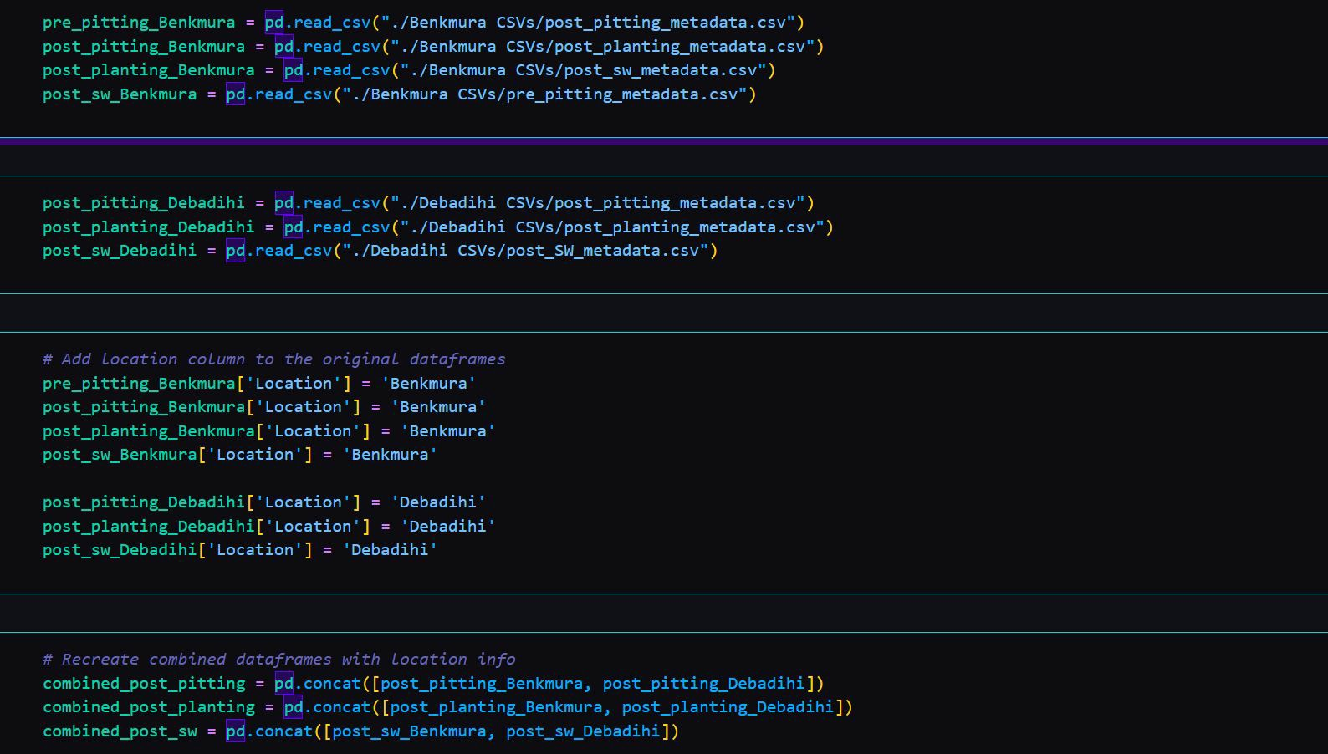
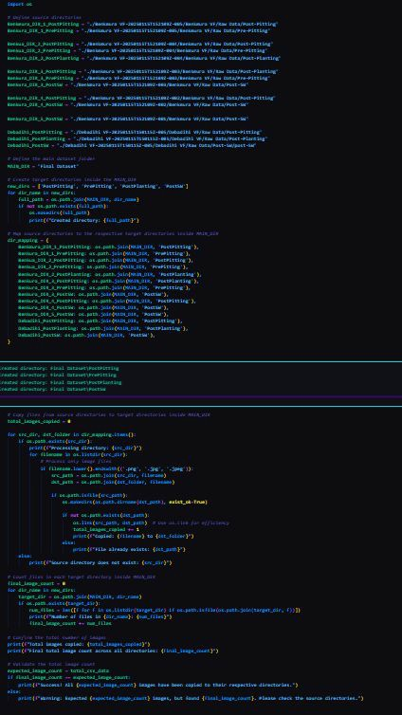






Slide 14
Drone Mapping and Image Analysis Using ODM
Overview
We use Open Drone Mapping (ODM) to track drone ﬂight paths, stitch images accurately, and create image masks for identifying pit holes within plots.
Pros :--
Enhanced Accuracy: Precise mapping improves the quality of ﬂight data.
Increased Efficiency: Automated stitching saves time and labor efforts.
Thorough Analysis: Image masks ensure detailed pit examinations.
Better Visualization: Isolating pits enhances clarity and understanding.
Versatility: Adaptable to various terrains and plot types.
Comprehensive Data Integration: Allows merging with other datasets for holistic analysis.

Slide 15
Cons :--
Inconsistent Image Alignment: Altitude and angle changes disrupt image matching.
Time-Consuming Manual Stitching: Stitching many images manually takes signiﬁcant amount of time.
Overlapping Pixels: Overlaps cause confusion in sub-images.

Slide 16
Step 2 : Isolating the Useful Areas using K Means
Pre-Processing the Data

Slide 17
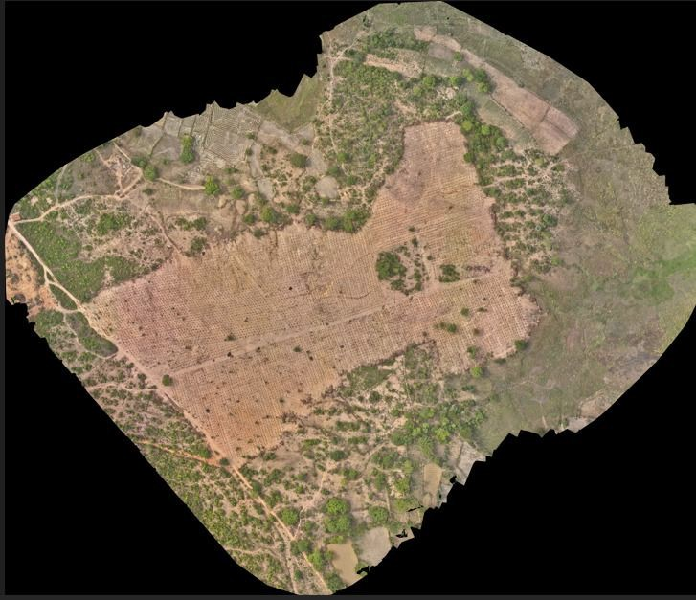
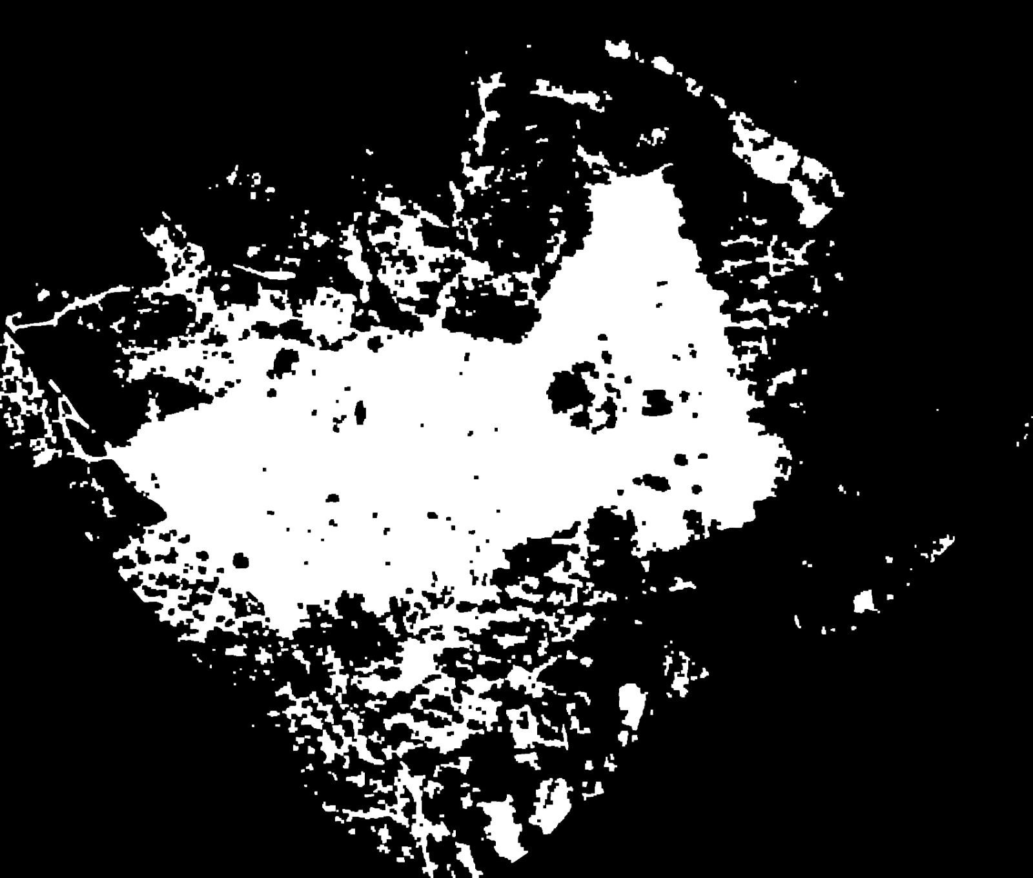
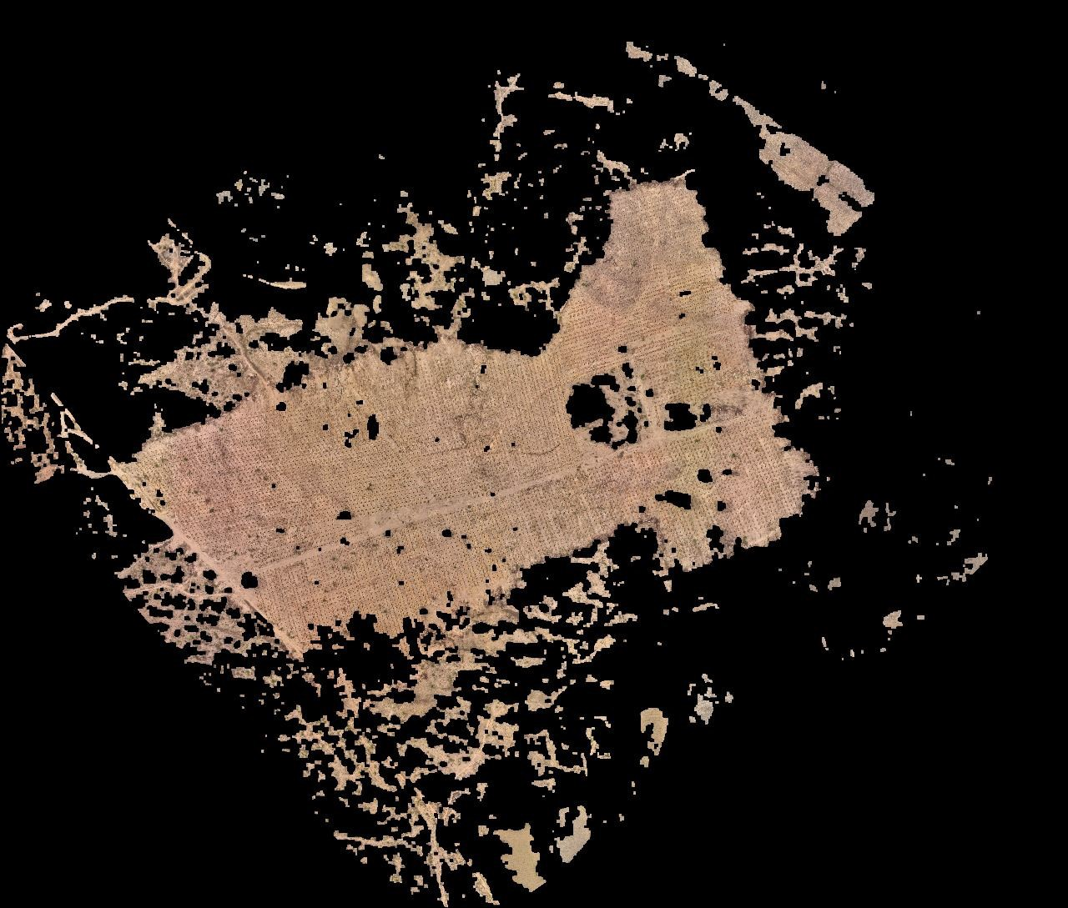
Isolation of Area of Interest for Pitt Numbering and Comparison

Slide 18
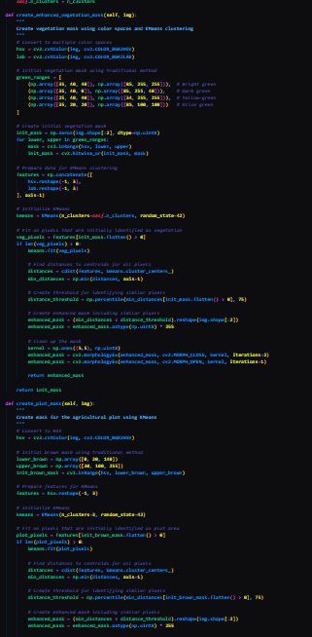
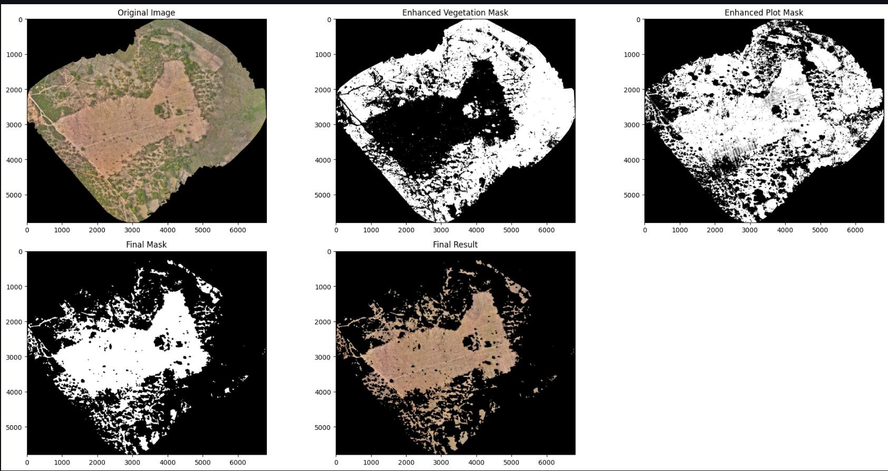

Slide 19
K-Means Clustering for Region of Interest Detection
Overview
Incorporated KMeans Clustering Algorithm along with CV2 to isolate green patches from yellow ones using a black-and-white mask for clear differentiation.
Pros
Easy Edge Detection: Simpliﬁes identifying edges within images.
Simple Algorithm: KMeans is easy to implement and adapt.
Time-Efﬁcient: Optimizes processing for quicker results.
Cons
Jittery Boundaries: Patch edges may appear inconsistent.
Boundary Noise: Noise at edges can reduce segmentation accuracy.

Slide 20
Step 3 : Indexing the Pitts for Model Training
Feature Engineering Step

Slide 21
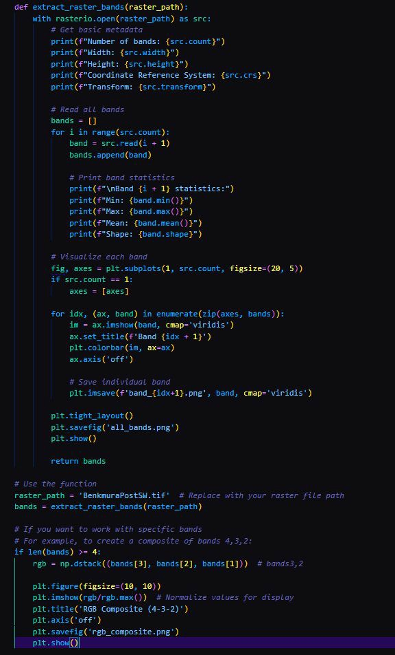
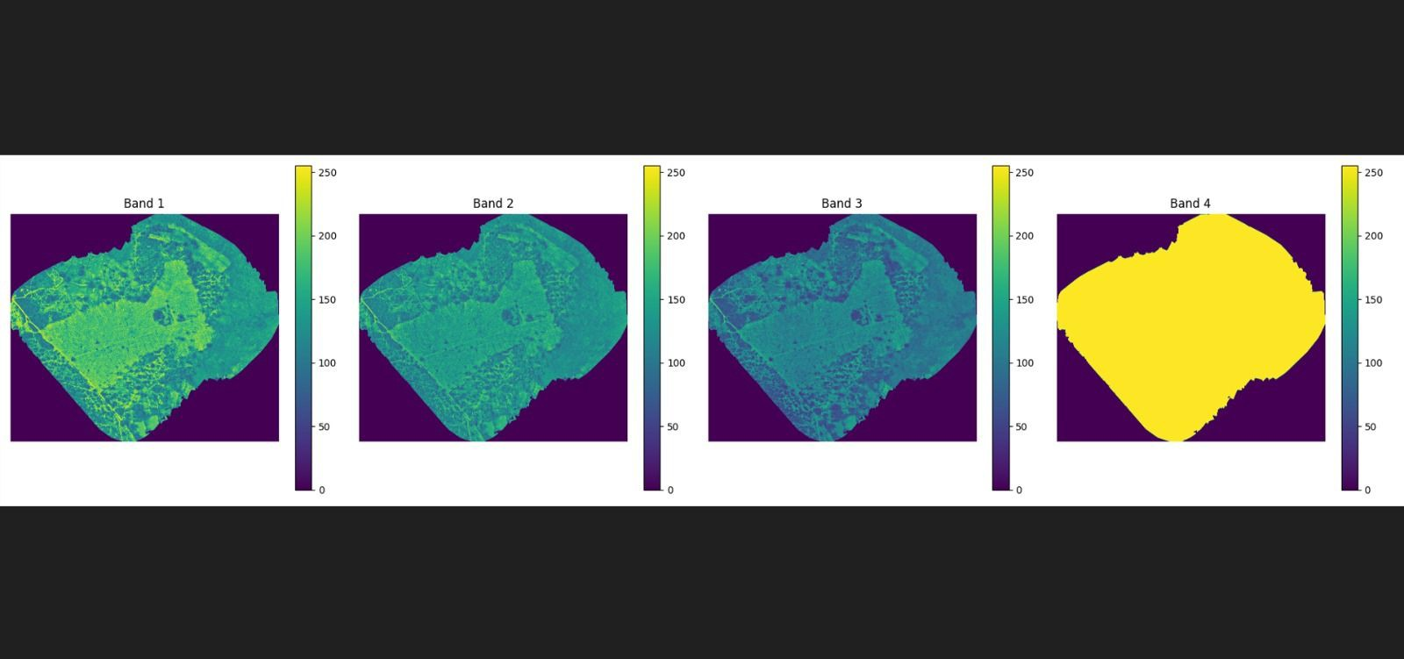

Using Rasterio to separate the Color Bands of the .Tiff ﬁle

Slide 22
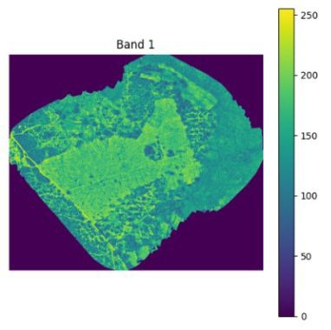
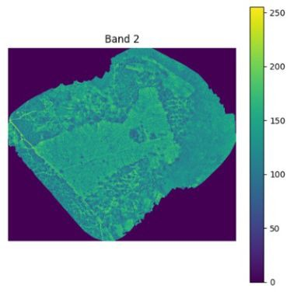




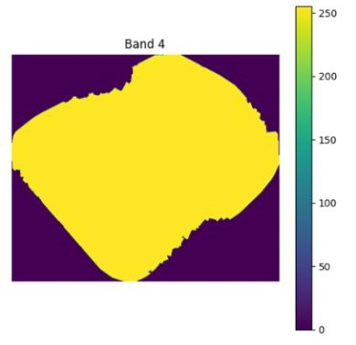
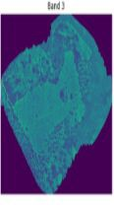

Color Band Extraction
1
2
4
22

Slide 23
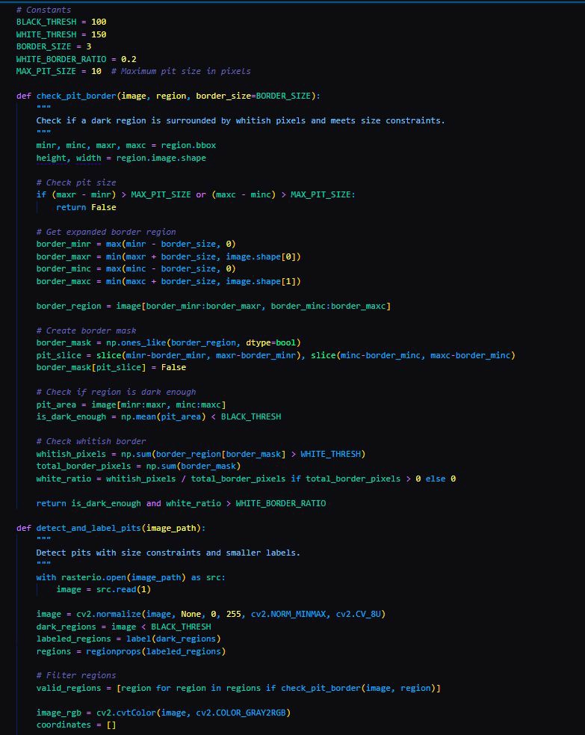
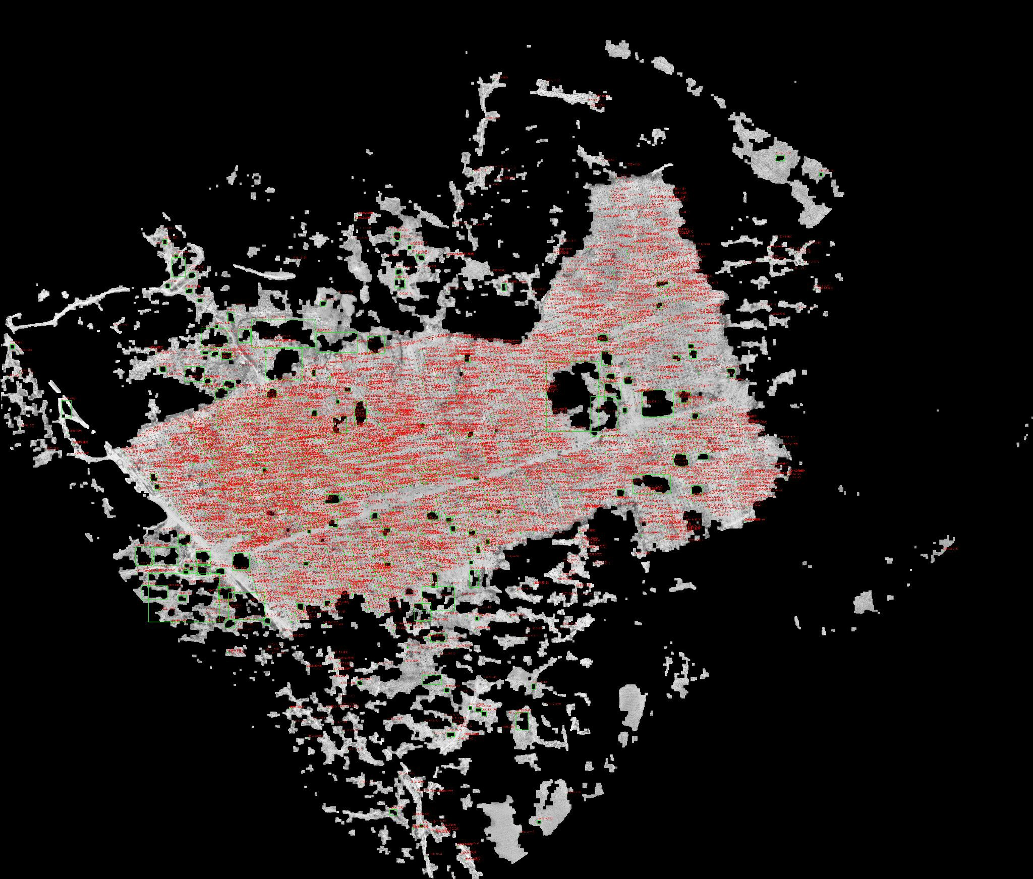
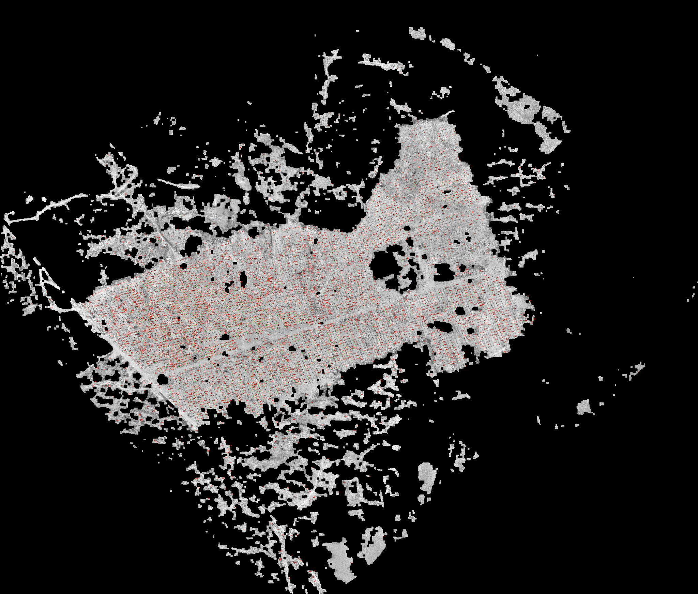
Pit Detection Algorithm
using CV2 after the color bandas have be optimised
231+++
+++++
+++++
+++++
+++++
+++++
+++++
+++++

Slide 24
Naive Green Check along with ConvMixer / NDVI Fusion:
Goal: Detect 45×45×45 cm pits in the above Pitt-Detected picture.
Implementation:
Simple Threshold & Labeling:
A thresholding technique identifies dark pixels.
Connected-component labeling is used to outline pit shapes.

Slide 25
 | Advanced Segmentation: Conv-Mixer or MobileNet has been used for compressed segmentation. Generates binary masks for pits and computes centroids for precise localization. This approach blends simplicity with advanced segmentation techniques for efficient and accurate pit detection.

Slide 26
Step 4 : Sapling Detection and Health Calculation
Model Training Phase

Slide 27
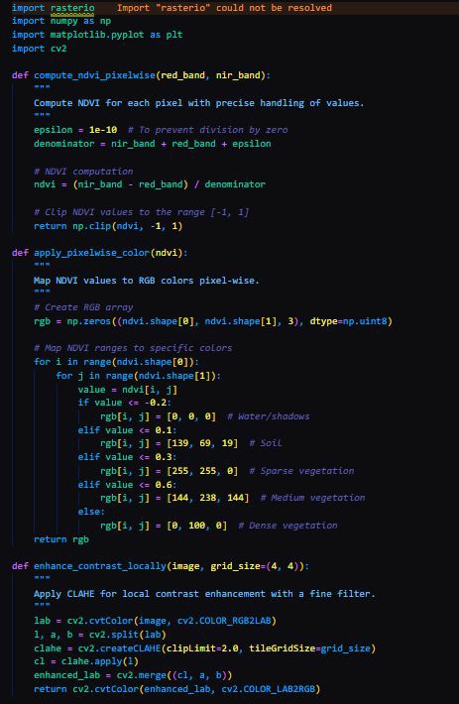
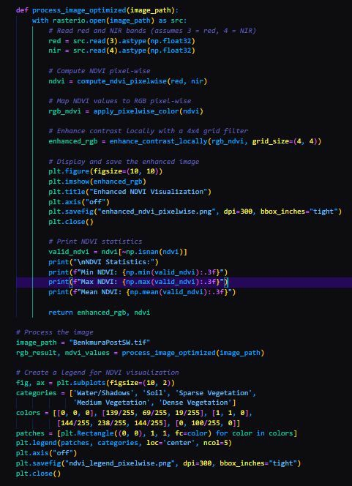
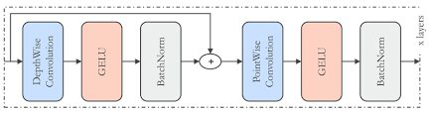
ConvMixer Model
27
++
++
++
++
1+++
+++
+++
+++
+++
+++++
+++++
+++++

Slide 28
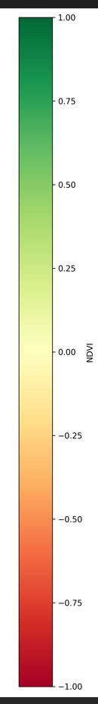
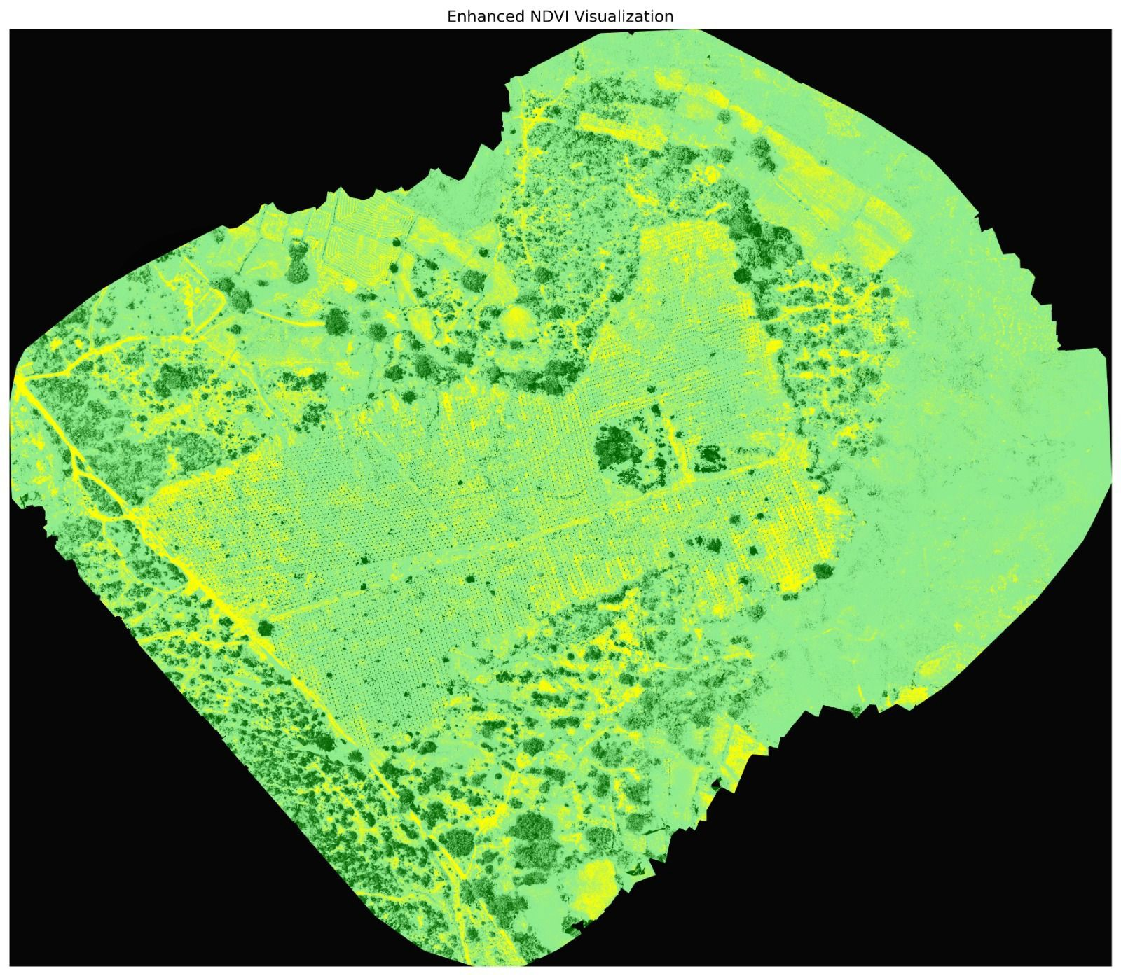
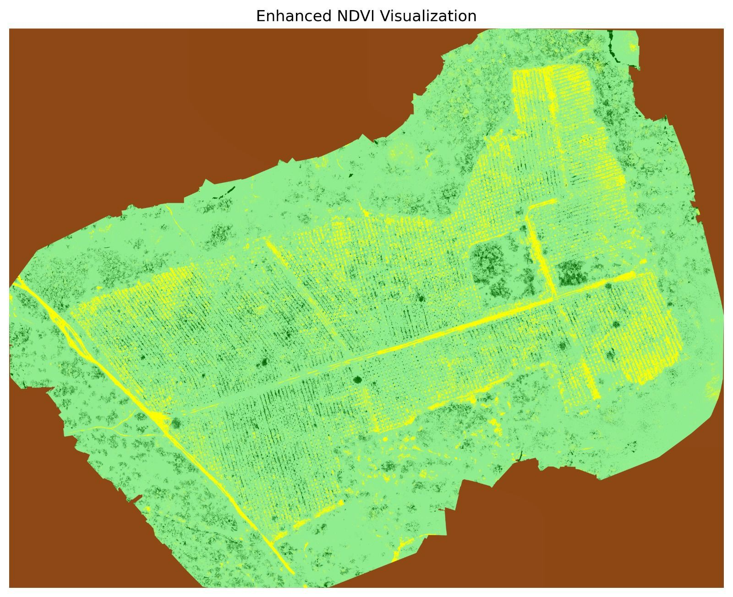
NDVI Index Output of Post-Planting and Post-SW

Slide 29
Normalized Difference Vegetation Index (NDVI)
Overview
NDVI measures vegetation presence and health, commonly used in remote sensing.
How It Works:
Data Source: Uses satellite data to measure visible and near-infrared light reﬂection.
Value Range: NDVI values range from -1 to 1:
Negative Values: Indicate water or clouds.
Positive Values: Indicate vegetation, with higher values representing denser vegetation.
Purpose:
An essential tool for monitoring vegetation health and density.

Slide 30
NDVI Formula: NDVI = (NIR+Red) / (NIR−Red)
NIR: Reﬂectance of near-infrared light
(healthy vegetation reﬂects more NIR).
Red: Reﬂectance of red light
(absorbed more by chlorophyll in healthy vegetation).
Why It Works:
Healthy vegetation strongly reﬂects NIR and absorbs red light, making NDVI a reliable measure of vegetation density and health.

Slide 31

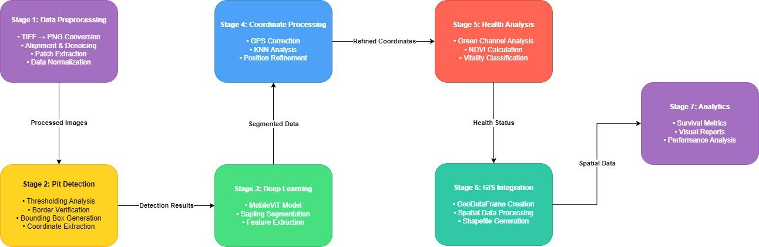
Complete Pipeline of the Model Architecture

Slide 32
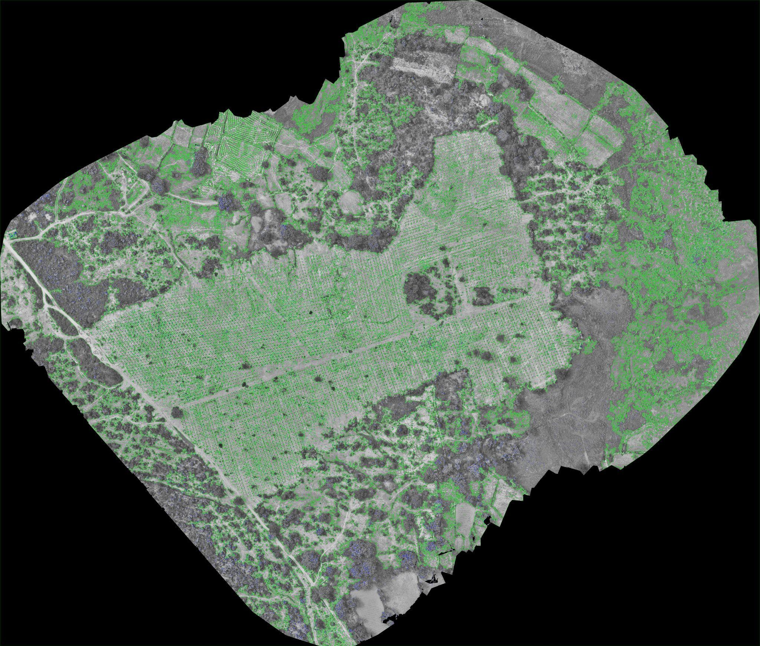
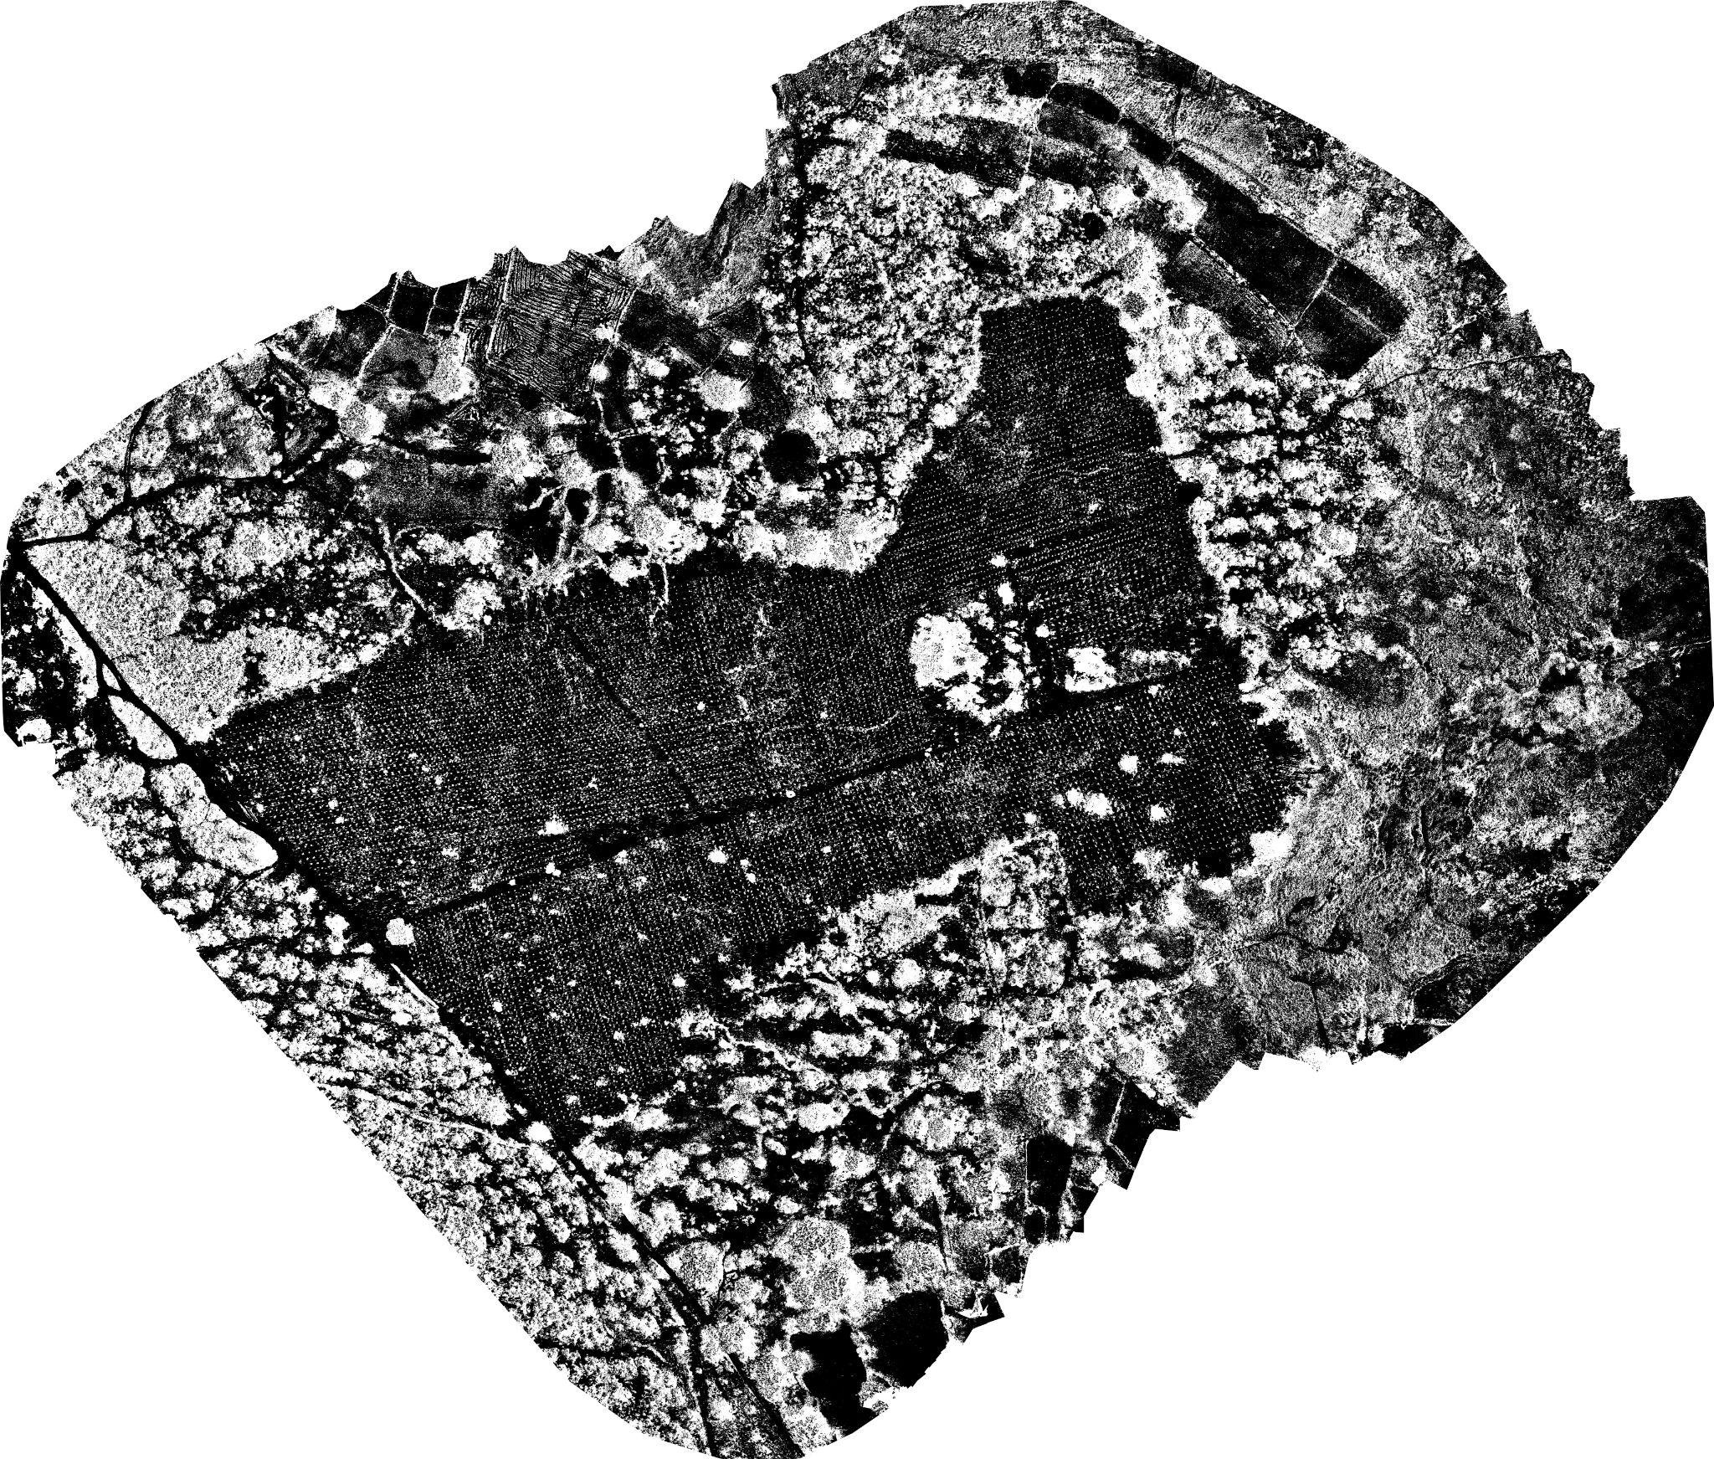
Stage 2 and Stage 3 Results

Slide 33
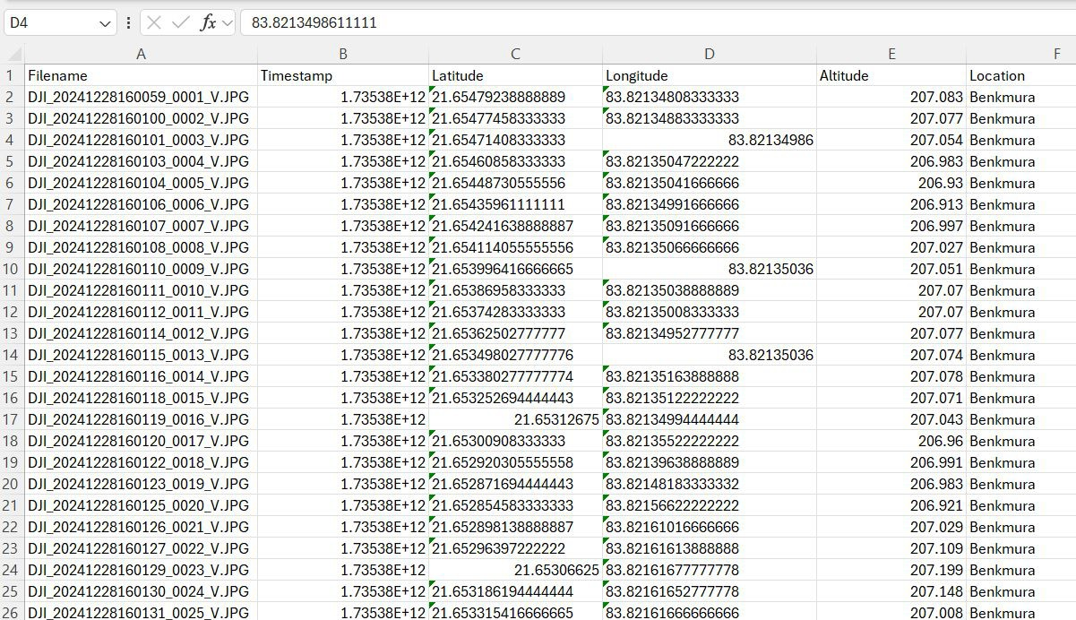
Stage 4 Results

Slide 34
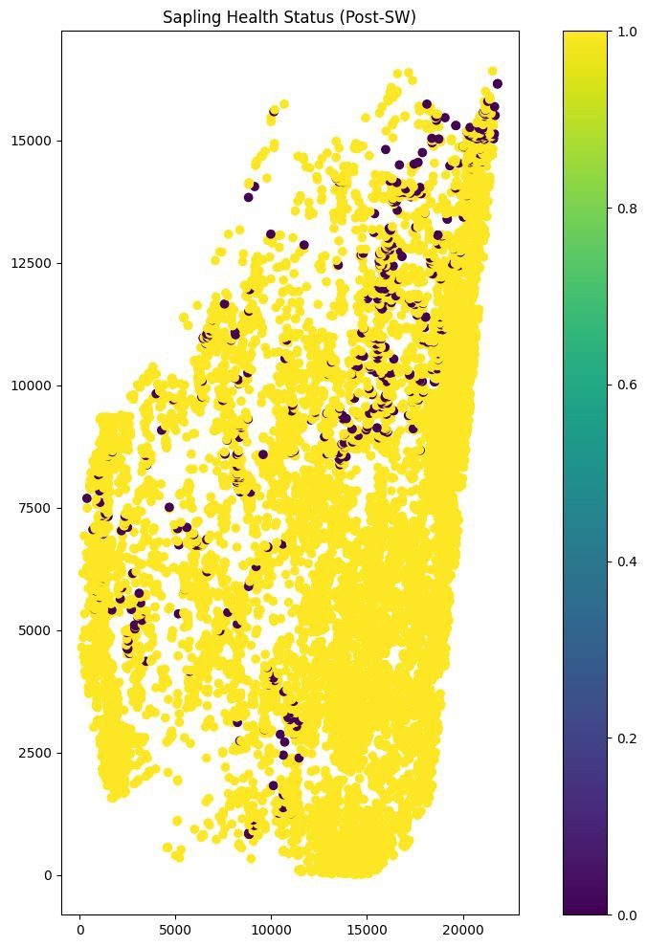
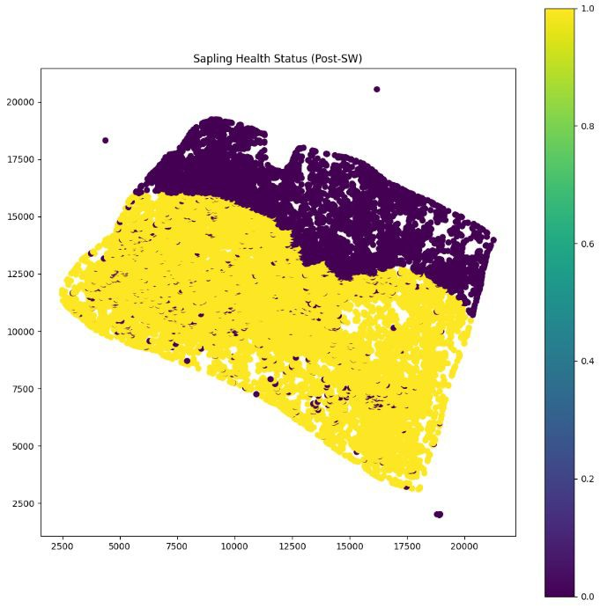
Stage 5 Results

Slide 35
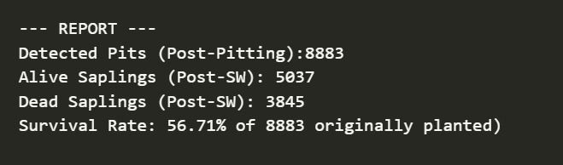
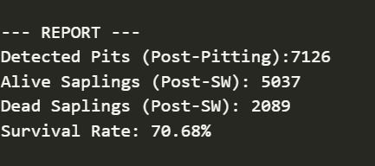
Final Results
Benkmura Health Analysis
Debadihi Health Analysis

Slide 36

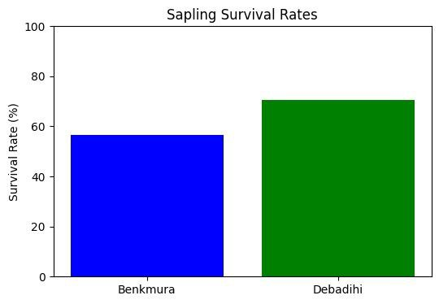

Slide 37
Project Timeline
The Model Takes a
.TIFF of the OrthoMosaic Image
1
Extracting the useful part of each Orthomosaic(The pitted areas)
3
Using NDVI along with ConvMixer to detect the population of healthy plants
5
2
4
6
Contouring out the Pitts in the land area along with indexing them for future use
Pre-processed the large Orthomosaic to produce a streamlined .png with reduced metadata for easier processing.
Model Training, Evaluation Metric and Performance result

Slide 38




SWOT ANALYSIS
STRENGTHS
WEAKNESSES
The data complexity demands extensive pre-processing, with
optimal results achievable only using infrared cameras.
Shadows, dense vegetation, or weather may mislead detection.
Real-time processing needs optimized hardware.
GPS inaccuracies affect spatial matching.
Dynamic Nature
Low-Latency Architecture
Simple mechanics, great for Edge Computing
Improve Data Quality: Use higher-resolution multispectral or hyperspectral imagery.
Better Preprocessing: Enhance image alignment and apply advanced noise reduction techniques.
OPPORTUNITIES
THREATS

Slide 39
42,538,764
Each day, the count of Dead Trunks continues to Rise!
Let’s ﬁx it together

